Slide 1

Data Structures Fundamentals (with Java)
Course Introduction
SoftUni Team
Technical Trainers
Software University
https://softuni.bg/

Slide 2
Table of Contents
Course Objectives
Training and Team
Course Organization
Course Infrastructure
Evaluation Criteria
2

Slide 3
Have a Question?
sli.do
#ds-java

Slide 4











SoftUni Diamond Partners

Slide 5



Educational Partners

Slide 6

Course Objectives

Slide 7
Course Objectives
Working with data structures and analyze algorithmic complexity
Implementing data structures
Comparison between similar operations
in different data structures
Building solid knowledge base on data storage implementation details and optimization problems in real time environment
7

Slide 8
Practical Programming Exam
Exam
3 practical problems for four hours
Linear Data Structures
Basic Trees
Breath First Search, Depth First Search
Heaps
BST
Everything included in the course
8

Slide 9
Theoretical Exam
You will have 30 minutes once you enter
20 questions with:
Multiple choice with only one correct answers
English
Automated quiz system
Available online at the day and time of the practical exam
You can submit your answers just once
9

Slide 10

The Team

Slide 11
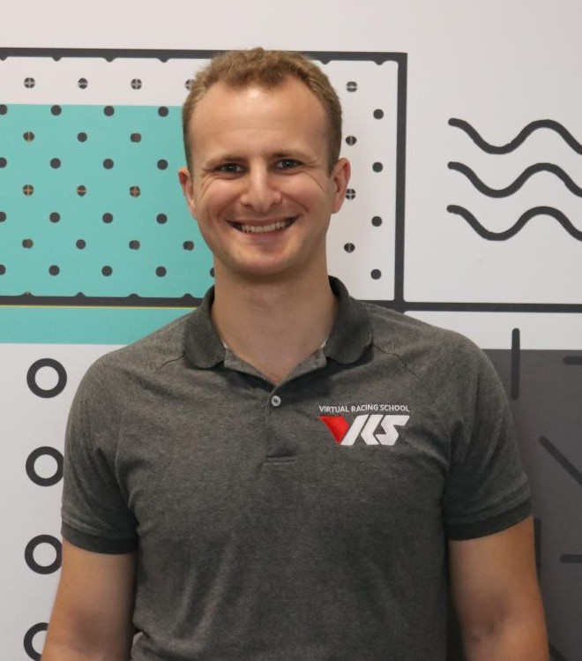
Georgi Georgiev
Technical trainer @ SoftUni
C++, C#, Java, Data Structures and others
Developer @ VirtualRacingSchool.com
Java, JavaScript, C++, C#
Experience
4+ years training, 10+ years coding
Wrote a driving simulator once in high school (DriveFreeZ award)
Played around with OpenGL, Bullet Physics SDK, WinRT

Slide 12

Ivaylo Jelev
Software Developer @ Codexio
5+ years in the IT
3+ years as a Technical Trainer @ SoftUni
Professional Problem Creator (Exam & Exercise Problems)
Interested in Game Development

Slide 13

Course Organization

Slide 14

Homework Assignments & Exercises
Your homework:
Lesson days → slides + live demos + exercises + tests
How to submit your homework?
For practical problems: Submitted in the judge system
For tests https://quiz.softuni.bg/
Do your homework when it's due
Assignments pile up quickly

Slide 15


SoftUni Certificate
Practical Exam 100%
Homework 5%
Evaluation

Slide 16
CPE Certificate
Practical Exam
Theoretical Exam
Evaluation

Slide 17



Course Web Site, Forum and FB Group
Official web site:
Official discussion forum:
Official Facebook group:
https://softuni.bg/trainings/2812/data-structures-fundamentals
https://softuni.bg/forum
https://www.facebook.com/groups/DataStructuresFundamentalswithJavaJune2021/

Slide 18
Questions?
Notes:
18

Slide 19
Trainings @ Software University (SoftUni)
Software University – High-Quality Education, Profession and Job for Software Developers
softuni.bg, about.softuni.bg
Software University Foundation
softuni.foundation
Software University @ Facebook
facebook.com/SoftwareUniversity
Software University Forums
forum.softuni.bg
19
Notes:
19

Slide 20

License
This course (slides, examples, demos, exercises, homework, documents, videos and other assets) is copyrighted content
Unauthorized copy, reproduction or use is illegal
© SoftUni – https://about.softuni.bg/
© Software University – https://softuni.bg
Notes:
20

